Slide 1
Instructions : Language of the Computer
Prepared By
R.Saranya
AP/CSE
KIOT

Slide 2
Topics to be covered
  Operations
  Operands
  Instruction Representation
  Logical Operations
  Decision Making
  MIPS Addressing

Slide 3
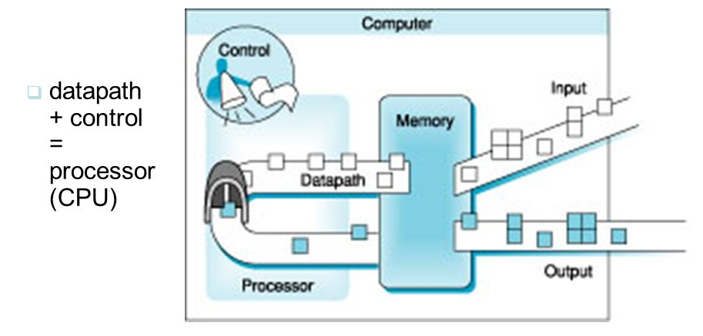
5 Classic Components of a Computer

Slide 4
MIPS Instruction Set
MIPS - Million Instructions Per Second
MIPS has 32 "general purpose registers"
It is a general measure of computing performance and, by implication , the amount of work a larger computer can do.
For large servers or mainframes, MIPS is a way to measure the cost of computing: the more MIPS delivered for the money, the better the value..
The number of MIPS attributed to a computer is usually determined by one or more benchmark runs.

Slide 5
Topic 1 : Operations
Arithmetic Operations:
C Language:
a=b+c;
MIPS assembly Language:
add a, b, c
For Eg If we want to sum four numbers b,c,d and e
add a, b, c # The sum of b and c is placed in a.
add a, a, d # The sum of b, c, and d is now in a.
add a, a, e # The sum of b, c, d, and e is now in a.

Slide 6
MIPS Operands
Name | Register Number | Usage | Preserved on call
$zero | 0 | Constant value o | n.a.
$at | 1 | Reserved for the assembler | n.a.
$v0 - $v1 | 2 – 3 | Value for results and expressions | No
$a0 - $a3 | 4 – 7 | Arguments(procedures / functions) | Yes
$t0 - $t7 | 8 – 15 | Temporaries | No
$s0 - $s7 | 16 – 23 | Saved | Yes
$t8 - $t9 | 24 – 25 | More temporaries | No
$k0 - $k1 | 26 – 27 | Reserved for the Operating System | n.a.
$gp | 28 | Global Pointer | Yes
$sp | 29 | Stack Pointer | Yes
$fp | 30 | Frame Pointer | Yes
$ra | 31 | Return address | Yes

Slide 7
MIPS Assembly Language
Arithmetic
Data transfer
Logical
Conditional branch
Unconditional jump

Slide 8
Arithmetic Operations
Instruction | Example | Meaning
Addition | add $s1,$s2,$s3 | $s1=$s2 + $s3
Subtraction | sub $s1,$s2,$s3 | $s1=$s2 - $s3
Multiply | mult $s1,$s2,$s3 | $s1=$s2 * $s3
Divide | div $s1,$s2,$s3 | $s1=$s2 / $s3
Add Immediate | addi $s1,$s2,20 | $s1=$s2 + 20
Subtraction Immediate | subi $s1,$s2,20 | $s1=$s2 – 20
Multiply Immediate | multi $s1,$s2,$s3 | $s1=$s2 * $s3
Divide Immediate | divi $s1,$s2,$s3 | $s1=$s2 / $s3

Slide 9
Data Transfer
Instruction | Example | Meaning
Load word | lw $s1,20($s2) | $s1 = Memory[$s2 + 20]
Store word | sw $s1,20($s2) | Memory[$s2 + 20] = $s1
Load half | lh $s1,20($s2) | $s1 = Memory[$s2 + 20]
Load half unsigned | lhu $s1,20($s2) | $s1 = Memory[$s2 + 20]
Store half | sh $s1,20($s2) | Memory[$s2 + 20] = $s1
Load byte | lb $s1,20($s2) | $s1 = Memory[$s2 + 20]
Load byte unsigned | lbu $s1,20($s2) | $s1 = Memory[$s2 + 20]
Store byte | sb $s1,20($s2) | Memory[$s2 + 20] = $s1
Load linked word | ll $s1,20($s2) | $s1 = Memory[$s2 + 20]
Store condition word | sc $s1,20($s2) | Memory[$s2+20]=$s1;$s1=0 or 1
Load upper Immediate | lui $s1,20 | $s1 = 20 * 216

Slide 10
Logical
Instruction | Example | Meaning
and | and $s1,$s2,$s3 | $s1 = $s2 & $s3
or | or $s1,$s2,$s3 | $s1 = $s2 | $s3
Nor | nor $s1,$s2,$s3 | $s1 = ~($s2 | $s3)
And Immediate | andi $s1,$s2,20 | $s1 = $s2 & 20
Or immediate | ori $s1,$s2,20 | $s1 = $s2 | 20
Shift left logical | sll $s1,$s2,10 | $s1 = $s2 << 10
Shift right logical | srl $s1,$s2,10 | $s1 = $s2 >> 10

Slide 11
Conditional branch
Instruction | Example | Meaning
branch on equal | beq $s1,$s2,25 | if ($s1 == $s2) go to PC + 4 + 100
branch on not equal | bne $s1,$s2,25 | if ($s1!= $s2) go to PC + 4 + 100
set on less than | slt $s1,$s2,$s3 | if ($s2 < $s3) $s1 = 1; else $s1 = 0
set on less than unsigned | sltu $s1,$s2,$s3 | if ($s2 < $s3) $s1 = 1; else $s1 = 0
set less than immediate | slti $s1,$s2,20 | if ($s2 < 20) $s1 = 1; else $s1 = 0
set less than immediate unsigned | sltiu $s1,$s2,20 | if ($s2 < 20) $s1 = 1; else $s1 = 0

Slide 12
Unconditional jump
Instruction | Example | Meaning
jump | j 2500 | Go to 10000
Jump register | jr $ra | Go to $ra
Jump and link | jal 2500 | $ra = PC +4; go to 10000

Slide 13
Design Principle 1: Simplicity favors regularity
  Regularity makes implementation simpler
  Simplicity enables higher performance at lower cost
For Eg:
C code:
f = (g + h) - (i + j);
Compiled MIPS code:
add t0, g, h # temp t0 = g + h
add t1, i, j # temp t1 = i + j
sub f, t0, t1 # f = t0 - t1

Slide 14
Topic 2 : Operands of the Computer Hardware
Two ways:
  Register Operands
  Memory Operands

Slide 15
Register Operands
Arithmetic instructions use register operands
Registers: Registers are primitives used in hardware design that are also visible to the programmer when the computer is completed
MIPS has a 32 × 32-bit register file
  Use for frequently accessed data
  Numbered 0 to 31
  32-bit data called a “word”

Slide 16
Design Principle 2: Smaller is faster
Clock cycle time
Assembler names
  $t0, $t1, …, $t9 for temporary values
  $s0, $s1, …, $s7 for saved variables
C code:
f = (g + h) - (i + j);
  f, …, j in $s0, …, $s4
Compiled MIPS code:
add $t0, $s1, $s2
add $t1, $s3, $s4
sub $s0, $t0, $t1

Slide 17
Memory Operand
The processor can keep only a small amount of data in registers, but computer memory contains billions of data elements. Hence, data structures (arrays and structures) are kept in memory
Data transfer instruction: A command that moves data between memory and registers
Address: A value used to delineate the location of a specific data element within a memory array.

Slide 18
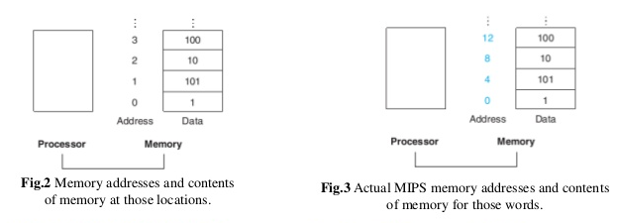

Slide 19
Memory Operand Example 1
C code:
g = h + A[8];
  g in $s1, h in $s2, base address of A in $s3
Compiled MIPS code:
  Index 8 requires offset of 32
    4 bytes per word
lw $t0, 32($s3) # load word
add $s1, $s2, $t0
offset
base register, i.e., rs

Slide 20
Memory Operand Example 2
C code:
A[12] = h + A[8];
  h in $s2, base address of A in $s3
Compiled MIPS code:
  Index 8 requires offset of 32
lw $t0, 32($s3) # load word
add $t0, $s2, $t0
sw $t0, 48($s3) # store word

Slide 21
Difference between register and memory
BASIS FOR COMPARISON | REGISTER | MEMORY
Basic | Registers hold the operands or instruction that CPU is currently processing. | Memory holds the instructions and the data that the currently executing program in CPU requires.
Capacity | Register holds the small amount of data around 32-bits to 64-bits. | Memory of the computer can range from some GB to TB.
Access | CPU can operate on register contents at the rate of more than one operation in one clock cycle. | CPU accesses memory at the slower rate than register.
Type | Accumulator register, Program counter, Instruction register, Address register, etc. | RAM.

Slide 22
Immediate Operands
For example, to add the constant 4 to register $s3, we could use the code
lw $t0, AddrConstant4($s1) # $t0 = constant 4
add $s3,$s3,$t0 # $s3 = $s3 + $t0 ($t0 == 4)
(OR)
addi $s3,$s3,4 # $s3 = $s3 + 4
Design Principle 3: Make the common case fast
  Small constants are common
  Immediate operand avoids a load instruction

Slide 23
The Constant Zero
MIPS register 0 ($zero) is the constant 0
  Cannot be overwritten
Useful for common operations
  E.g., move between registers
  add $t2, $s1, $zero

Slide 24
Signed and Unsigned Numbers
Signed Numbers
LSB: Least Significant Bit =>rightmost bit
MSB: Most Significant Bit =>leftmost bit
For eg:
(+3) = 0011 (-3) = 1011
UnSigned Numbers
unsigned then all the bits can be used to represent the number.
For eg:
(5) = 0101

Slide 25
Decimal to Binary Conversion
For example:
Convert 123₁₀ to (?)₂
Soln:
123₁₀ = 1111011₂
Binary to Decimal Conversion
For example:
Convert 1101₂ to (?)₁₀
Soln:
1×2³ + 1×2² + 0×2¹ + 1×2⁰ = 11₁₀
digits: | 1 | 1 | 0 | 1
numbering: | 3 | 2 | 1 | 0

Slide 26
1’s Complement: Transforming the 0 bit to 1 and the 1 bit to 0.
For Eg:
1's complement of "0111" is "1000“
2’s Complement: Binary number is 1 added to the 1’s complement of the binary number.
For eg:
2's complement of "0111" is "1001"

Slide 27
Negation Shortcut
Negate 16 bit binary versions of 10₁₀ and check the result by negating -10₁₀ to 32 bit binary numbers
Soln:
16 bit binary value
10₁₀ = 0000 0000 0000 1010₂
Convert to 32 bit number
10₁₀ = 0000 0000 0000 0000 0000 0000 0000 1010₂
Continued

Slide 28
To Negate:
Find 1’s Complement
10₁₀ = 0000 0000 0000 1010₂
= 1111 1111 1111 0101₂
ii) Find 2’s Complement:
1111 1111 1111 0101
1 (+)
1111 1111 1111 0110
1111 1111 1111 1111 1111 1111 1111 0110₂ = -10 ₁₀

Slide 29
Solve ???
Convert binary to decimal:
      1001 0011 0010 0001
Convert decimal to binary: 1451
Find 1’s complement and 2’s complement for 10010111
Negate 27₁₀ to -27₁₀

Slide 30
Instruction Representation
MIPS Fields :
  R-Type
  I-type
R-Type:
6 bits 5 bits 5 bits 5 bits 5 bits 6 bits
op -> Basic operation
rs -> First register src operand
rt ->second register src operand
rd -> register destination operand
shamt ->shift amount
funct ->function
OP | RS | RT | RD | SHAMT | FUNCT

Slide 31
Translating a MIPS Assembly Instruction into a Machine Instruction
Example:
The real MIPS language version of the instruction represented symbolically as
add $t0,$s1,$s2
first as a combination of decimal numbers and then of binary numbers.

Slide 32
Solution:
Given: add $t0,$s1,$s2
The decimal representation is
Src 1=> $s1=17 Src 2=> $s1=17 dest=> $t0=8 empty filed set to 0
This instruction can also be represented as fields of binary numbers as opposed to decimal:
6 bits 5 bits 5 bits 5 bits 5 bits 6 bits Fig: Instruction format
0 | 17 | 18 | 8 | 0 | 32
000000 | 10001 | 10010 | 01000 | 00000 | 100000

Slide 33
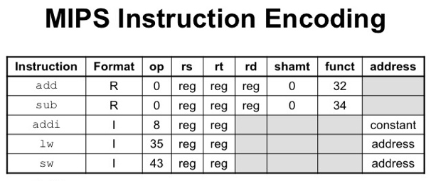
Design Principle 3: Good design demands good compromises
I-type: Constant and Immediate value
6bits 5bits 5bits 16 bits
OP | RS | RT | Constant or address

Slide 34
EXAMPLE
If $t1 has the base of the array A and $s2 corresponds to h, the assignment statement
A[300] = h + A[300];
is compiled into
lw $t0,1200($t1) Temporary reg $t0 gets A[300]
add $t0,$s2,$t0 # Temporary reg $t0 gets h + A[300]
sw $t0,1200($t1) # Stores h + A[300] back into A[300]
What is the MIPS machine language code for these three instructions?

Slide 35
Convert machine language instructions to decimal
Convert the values into binary
op | rs | rt | rd | address/shmat | function
35 | 9 | 8 | 1200
0 | 18 | 8 | 8 | 0 | 32
43 | 9 | 8 | 1200
op | rs | rt | rd | address/shmat | function
100011 | 01001 | 01000 | 0000 0100 1011 0000
00000 | 10010 | 01000 | 01000 | 00000 | 100000
101011 | 01001 | 01000 | 0000 0100 1011 0000

Slide 36
SOLVE ????
sub A,B,C
add C,A,B
sub C,B,A
sub C,A,B
Convert it into MIPS assembly language and also find MIPS Instruction?

Slide 37
Topic 3 : Instruction Representation
MIPS Fields :
  R-Type
  I-type
R-Type:
6 bits 5 bits 5 bits 5 bits 5 bits 6 bits
op -> Basic operation
rs -> First register src operand
rt ->second register src operand
rd -> register destination operand
shamt ->shift amount
funct ->function
OP | RS | RT | RD | SHAMT | FUNCT

Slide 38
Translating a MIPS Assembly Instruction into a Machine Instruction
Example:
The real MIPS language version of the instruction represented symbolically as
add $t0,$s1,$s2
first as a combination of decimal numbers and then of binary numbers.

Slide 39
Solution:
Given: add $t0,$s1,$s2
The decimal representation is
Src 1=> $s1=17 Src 2=> $s1=17 dest=> $t0=8 empty filed set to 0
This instruction can also be represented as fields of binary numbers as opposed to decimal:
6 bits 5 bits 5 bits 5 bits 5 bits 6 bits Fig: Instruction format
0 | 17 | 18 | 8 | 0 | 32
000000 | 10001 | 10010 | 01000 | 00000 | 100000

Slide 40
Design Principle 3: Good design demands good compromises
I-type: Constant and Immediate value
6bits 5bits 5bits 16 bits
OP | RS | RT | Constant or address

Slide 41
EXAMPLE
If $t1 has the base of the array A and $s2 corresponds to h, the assignment statement
A[300] = h + A[300];
is compiled into
lw $t0,1200($t1) Temporary reg $t0 gets A[300]
add $t0,$s2,$t0 # Temporary reg $t0 gets h + A[300]
sw $t0,1200($t1) # Stores h + A[300] back into A[300]
What is the MIPS machine language code for these three instructions?

Slide 42
Convert machine language instructions to decimal
Convert the values into binary
op | rs | rt | rd | address/shmat | function
35 | 9 | 8 | 1200
0 | 18 | 8 | 8 | 0 | 32
43 | 9 | 8 | 1200
op | rs | rt | rd | address/shmat | function
100011 | 01001 | 01000 | 0000 0100 1011 0000
00000 | 10010 | 01000 | 01000 | 00000 | 100000
101011 | 01001 | 01000 | 0000 0100 1011 0000

Slide 43
J-type: Jump Instruction
6bits 26 bits
For Example:
J 2500
2 | 2500
000010 | 00000000000000100111000100

Slide 44
SOLVE ????
sub A,B,C
add C,A,B
sub C,B,A
sub C,A,B
Convert it into MIPS assembly language and also find MIPS Instruction?

Slide 45
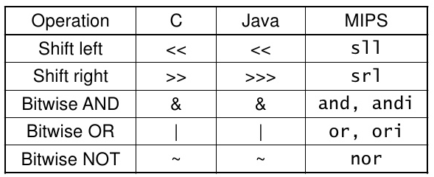
  Topic 4 : Logical Operations
The packing and unpacking of bits into words is called as logical operations

Slide 46
Shift Left
For example, if register $s0 contained
add 0000
Shift Left by 4
0000 | 0000 | 0000 | 0000 | 0000 | 0000 | 0000 | 1001
9
0000 | 0000 | 0000 | 0000 | 0000 | 0000 | 1001 | 0000
144

Slide 47
Shift Right
For example, if register $s0 contained
add 0000
Shift Right by 4
0000 | 0000 | 0000 | 0000 | 0000 | 0000 | 1001 | 0000
144
0000 | 0000 | 0000 | 0000 | 0000 | 0000 | 0000 | 1001
9

Slide 48
MIPS Language
sll $t2,$s0,4 # $t2 = $s0 << 4bits
Here sll and srl are in R-Format
6 bits 5 bits 5 bits 5 bits 5 bits 6 bits
For above example R-Format
sll no field $s0 $t2 shmat
OP | RS | RT | RD | SHAMT | FUNCT
0 | 0 | 16 | 10 | 4 | 0

Slide 49
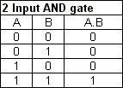

AND Gate

Slide 50
Example
if register $t2 contains
and register $t1 contains
MIPS Instruction
and $t0,$t1,$t2 # $t0 = $t1 & $t2
the value of register $t0 would be
0000 | 0000 | 0000 | 0000 | 0000 | 1101 | 1100 | 0000
0000 | 0000 | 0000 | 0000 | 0011 | 1100 | 0000 | 0000
0000 | 0000 | 0000 | 0000 | 0000 | 1100 | 0000 | 0000

Slide 51

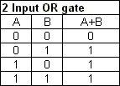
OR Gate

Slide 52
Example
if register $t2 contains
and register $t1 contains
MIPS Instruction
or $t0,$t1,$t2 # $t0 = $t1 | $t2
the value of register $t0 would be
0000 | 0000 | 0000 | 0000 | 0000 | 1101 | 1100 | 0000
0000 | 0000 | 0000 | 0000 | 0011 | 1100 | 0000 | 0000
0000 | 0000 | 0000 | 0000 | 0011 | 1101 | 1100 | 0000

Slide 53


NOT Gate

Slide 54
Example
if register $t2 contains
and register $t1 contains
MIPS Instruction
nor $t0,$t1,$t2 # $t0 = ~($t1 | $t2)
the value of register $t0 would be
OR Value:
NOR(NOT+OR):
0000 | 0000 | 0000 | 0000 | 0000 | 1101 | 1100 | 0000
0000 | 0000 | 0000 | 0000 | 0011 | 1100 | 0000 | 0000
0000 | 0000 | 0000 | 0000 | 0011 | 1101 | 1100 | 0000
1111 | 1111 | 1111 | 1111 | 1100 | 0010 | 0011 | 1111

Slide 55
SOLVE????
sll $t2,$s2<<4
srl $t3 , $s3>>4
and $t0,$s1,$s2
or $t0,$s1,$s2
nor $t0,$s1,$s2

Slide 56
Topic 4 : Decision Making
High-level languages: if-else, for, while, etc.
Instruction set: can be accomplished with a combination of the following:
  branch on comparison
  goto (“jump”)
  labels

Slide 57
beq: branch if equal
bne: branch if not equal
j: jump (unconditional)
  jump address table: list of addresses for various program possibilities switch statements.
slt/slti: set on less than {register, immediate}
  compares the contents of 2 registers; 3rd register is set to 1 if first register is less than second register, 0 otherwise

Slide 58
Conditional Branches
Beq:Branch if equal
  Syntax: beq register1, register2, L1
    This instruction means go to the statement labeled L1 if the value in register1 equals the value in register
bne: branch if not equal
  Syntax: bne register1, register2, L1
    This instruction means go to the statement labeled L1 if the value in register1 does not equal the value in register2

Slide 59
Example
if (i == j)
i = j i ≠ j
f = g + h;
else Else:
f = g – h;
i==j ?
f=g+h
f=g-h
exit

Slide 60
MIPS Code:
bne $s3,$s4,Else # go to Else if i ≠ j
add $s0,$s1,$s2 # f = g + h (skipped if i ≠ j)
j Exit # go to Exit
Else:sub $s0,$s1,$s2 # f = g – h (skipped if i = j)
Exit:

Slide 61
LOOPS
C Code:
while (save[i] == k)
i += 1;
MIPS Code:
Loop: sll $t1,$s3,2 # Temp reg $t1 = i * 4
add $t1,$t1,$s6 # $t1 = address of save[i]
lw $t0,0($t1) # Temp reg $t0 = save[i]
bne $t0,$s5, Exit # go to Exit if save[i] ≠ k
addi $s3,$s3,1 # i = i + 1
j Loop # go to Loop
Exit:

Slide 62
Case/Switch Statement
switch(k){
case 0: f=i+j;break;
case 1: f=g+h;break;
case 2:
f=g-h;break;
case 3:
f=i-j;break;
}
slt $t3,$s5,$zero # test if k=4
add $t1,$s5,$s5 #$t1 =2*k
add $t1,$t1,$t1 #$t1 =4*k
add $t1,$t1,$t4 #$t1=address of JumpTable[k]
lw $t0,0($t1) #$to=JumpTable[k] jr $t0 #jump based on register $t0
L0: add $s0,$s3,$s4
j Exit
L1: add $s0,$s1,$s2
j Exit
L2: sub $s0,$s1,$s2
j Exit
L3: sub $s0,$s3,$s4
Exit:

Slide 63
Topic 5 : MIPS Addressing
Immediate Addressing
Register Addressing
Base or displacement Addressing
PC-relative addressing
Pseudodirect addressing

Slide 64
Immediate Addressing
Eg: add r3,r2,20
Register Addressing
Eg: add r3,r2,r1

Slide 65
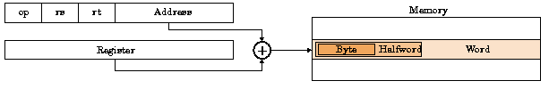
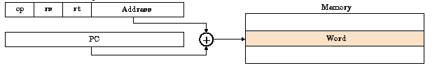
Base Addressing:
Eg:lw $t1 , 4 ($t2)
PC –relative addressing:

Slide 66
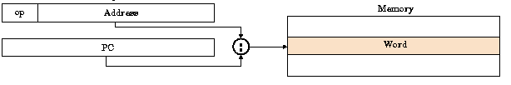
Pseudodirect Addressing

